Slide 1


European Players Rating
Black Belts

Slide 2
Contents
It’s composed of hydrogen and helium
Has a very poisonous atmosphere
Dataset
EDA
ML models
Business objectives
Preprocessing
Evaluation

Slide 3
Dataset

Slide 4
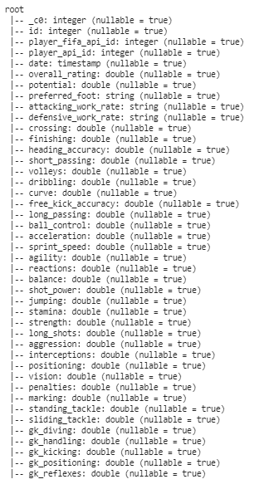
DataSet
What you get:
+10,000 players
Seasons 2007 to 2016
+25,000 matches
11 European Countries with their lead championship
41
Features
183978
No. of entries

Slide 5
Business Objectives

Slide 6
Objectives
Obj#1
How can FIFA predict player rating based on their skills and attributes to choose the best player?
Obj#2
How can teams sign contracts with players based on their skills and attributes as per the team's need?

Slide 7
EDA

Slide 8
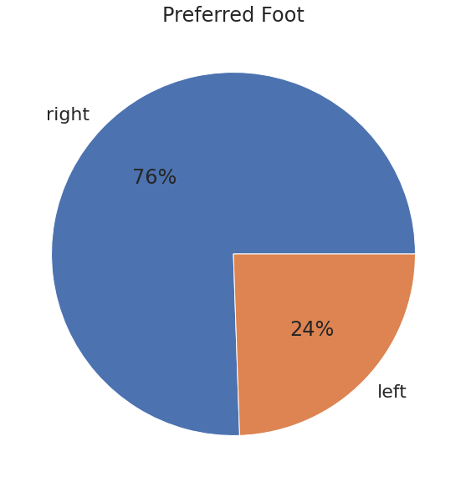
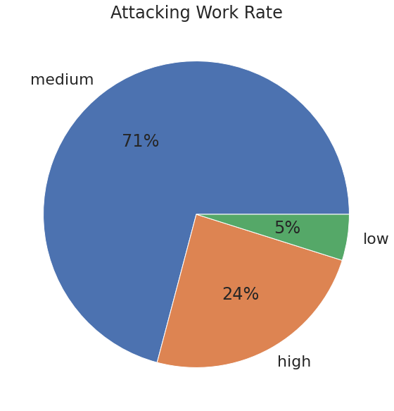
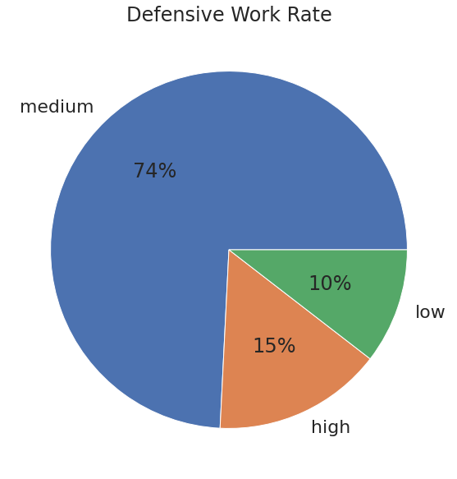
Categorical Features

Slide 9
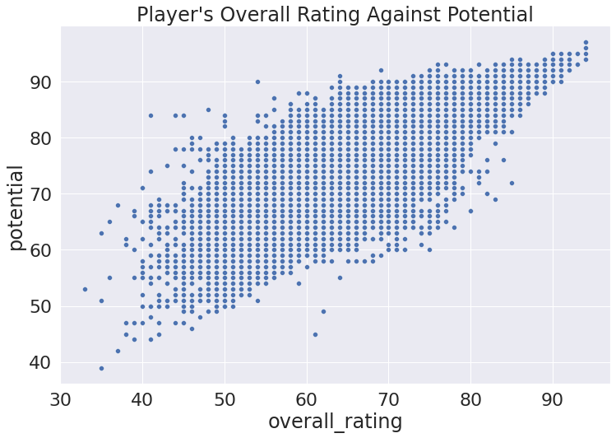
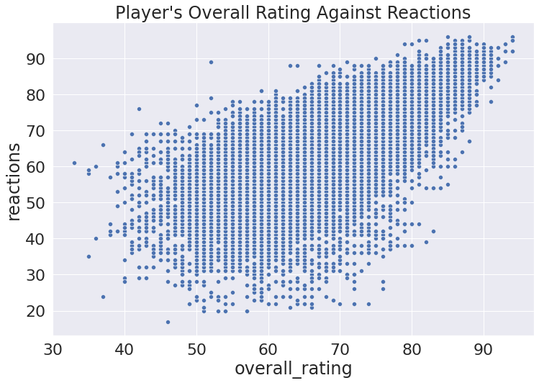
Overall Rating Against Potential & Reactions

Slide 10
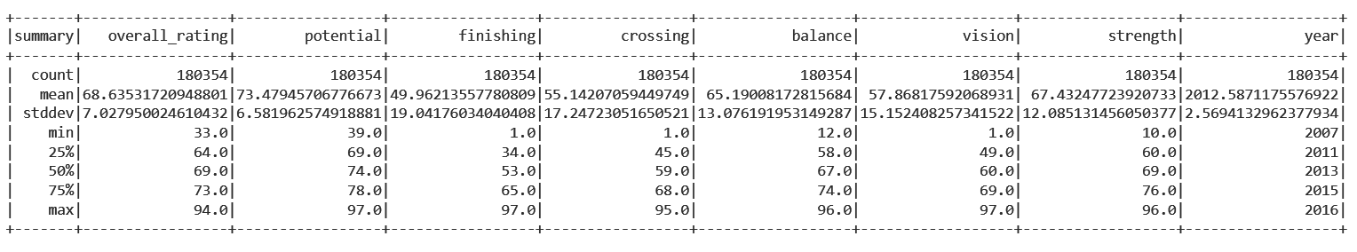
Summary of a part of the numerical columns

Slide 11
Preprocessing

Slide 12
Preprocessing Steps
1
2
3
4
Alter Date
Drop NA
Drop unnecessary
Encode Categorical
Split Timestamp into Year, Month. Then drop the original
Drop 3,624 Missing Values
(2% of total data)
_c0 , id, player_fifa_api_id, player_api_id
Using StringIndexer

Slide 13
Combining Feature Columns
Target
overall_rating
Features
Combined all using
VectorAssembler

Slide 14
Split Dataset
90:00
Train
Dataset
Test Dataset
75:25

Slide 15
ML Models

Slide 16
Regression Models
Gradient Boosted Tree Regressor
Decision Tree Regressor
1
0
Linear Regression
Random Forest Regressor

Slide 17
Evaluation

Slide 18
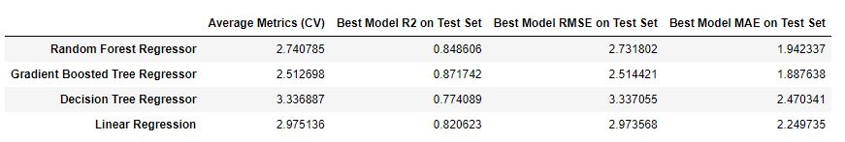
Regression ML Models
Notes:
Mean Absolute Error, Root Mean Square Error, R-squared , coefficient of variation

Slide 19
Models Results
2nd
1st
3th
Random Forest Regressor
Gradient Boosted Tree Regressor
Linear Regression

Slide 20
Thank You
Any Questions?
Vision
Black Belts
Vision
Black Belts
Instructors
Ninjas
Black Belts
Hokages
BTD
Hokages
BTD
Avengers
DaQuest

